Slide 1





Basic Web Development with Java
Spring MVC, Spring Boot, Thymeleaf, Hibernate
Java &
Spring
SoftUni Team
Technical Trainers
Software University
http://softuni.bg

Slide 2


Table of Contents
Java Web with Spring MVC
Spring MVC and Spring Boot
Getting Started with Spring Boot
Annotations
Controllers
Processing Requests
Thymeleaf View Engine
Hibernate ORM
Spring Data

Slide 3
Have a Question?
sli.do #fund-softuni

Slide 4


Java Web Development
Spring MVC, Thymeleaf, Hibernate

Slide 5

Spring MVC
Spring MVC == open source Web MVC framework for Java
Developed by Pivotal Software, as part of Spring Framework
https://spring.io
Built top of Java Servlet API
https://javaee.github.io/tutorial/servlets.html
Based on the Model-View-Controller (MVC) architecture
Controllers handle HTTP GET / POST requests and render views
Views render HTML using a template engine (e.g. JSP or Thymeleaf)
Models access persistent data (e.g. from the database or cloud)

Slide 6
Spring Boot
Configuration with Spring Boot
Simplifies building Spring applications
Convention-over-configuration
Rapid application development with Spring
Create production-grade applications that you can “just run”
Automatically configure Spring Framework (very simplified)
Built-in (embedded) Web server (Tomcat)
Integrates Spring MVC, Spring Data and other Spring technologies

Slide 7
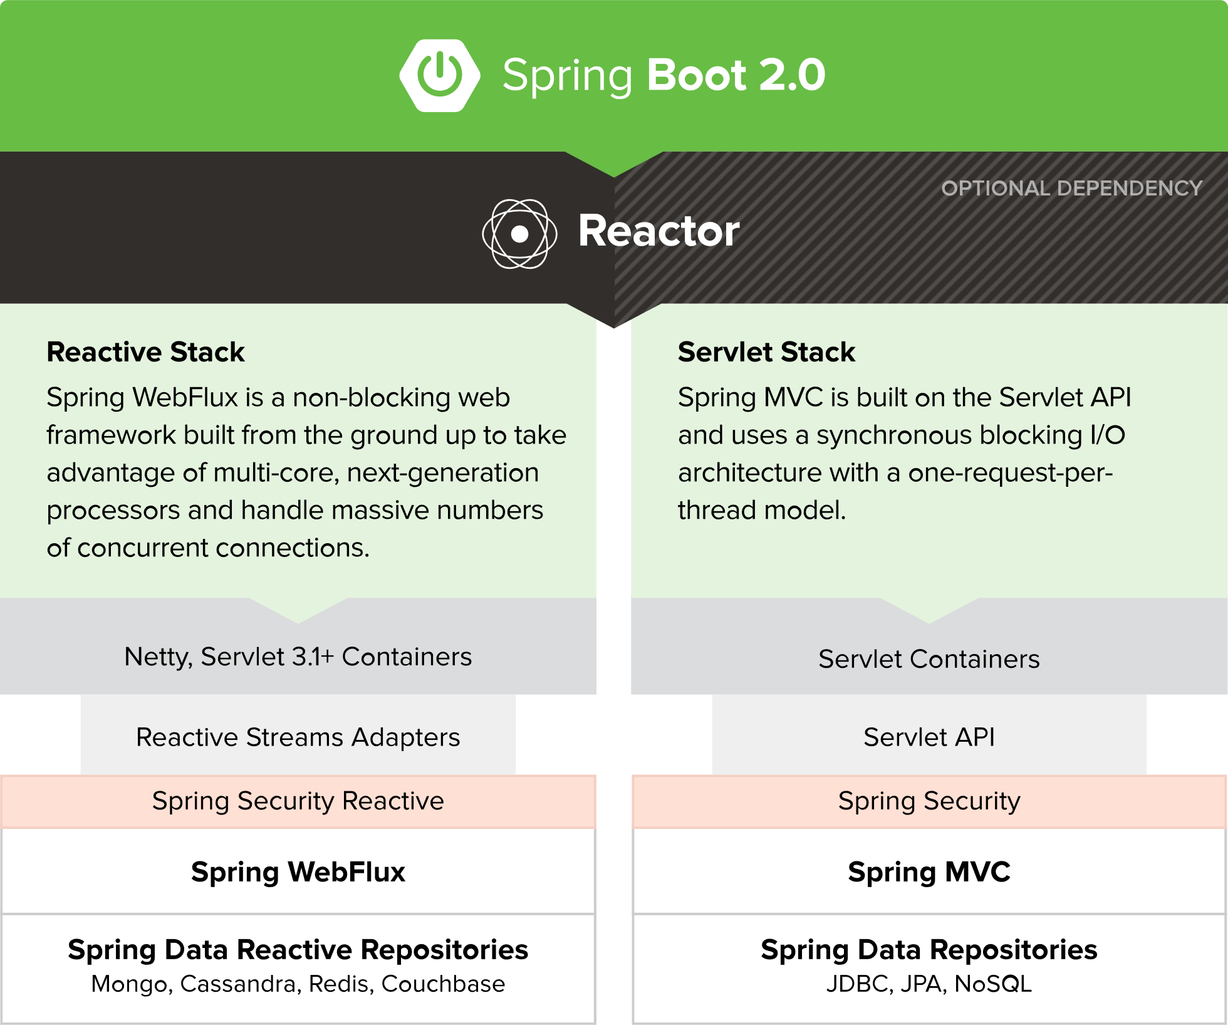
Spring Boot

Slide 8
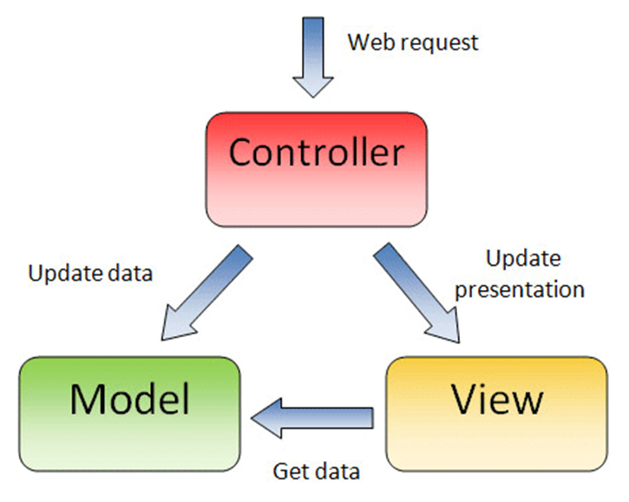
What is Model-View Controller (MVC)?
MVC == Model-View-Controller
Views (presentation / UI)
Render UI (produce HTML)
Controllers (logic)
Prepare UI (presentation logic)
Update database (business logic)
Models (data)
Data access classes or ORM

Slide 9
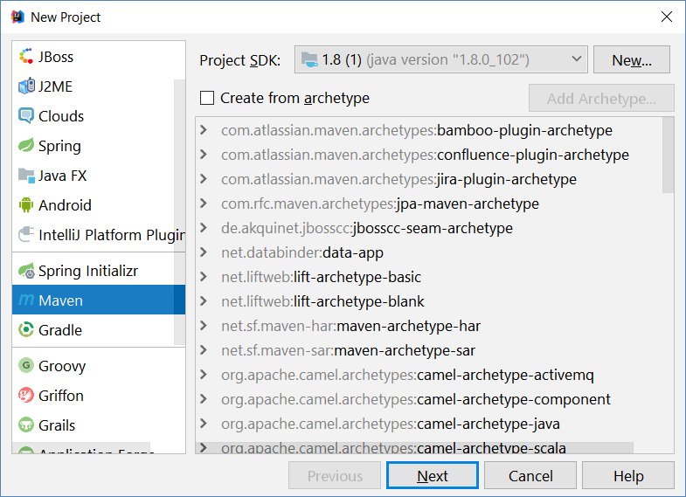
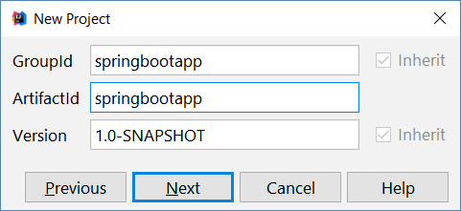
Starting with Spring Boot (Maven Project)
Create a new Maven-based Java project

Slide 10
Starting with Spring Boot (Maven Project)
pom.xml
<parent>
<groupId>org.springframework.boot</groupId>
<artifactId>spring-boot-starter-parent</artifactId>
<version>1.5.9.RELEASE</version>
</parent>
<dependencies>
<dependency>
<groupId>org.springframework.boot</groupId>
<artifactId>spring-boot-starter-thymeleaf</artifactId>
</dependency>
</dependencies>
<properties><java.version>1.8</java.version></properties>
Inherit "spring-boot-starter-parent"
Include the Spring MVC + Boot + Thymeleaf libraries
Use Java 8

Slide 11
Spring Boot Application Class
src/main/java/app/MvcAppExample.java
package app;
import org.springframework.boot.*;
import org.springframework.boot.autoconfigure.*;
@SpringBootApplication
public class MvcAppExample {
public static void main(String[] args) {
SpringApplication.run(MvcAppExample.class, args);
}
}
Using a package is obligatory!
Configure the Spring Boot app
Run the Spring Framework app

Slide 12
Controllers
MVC controllers hold actions, mapped to URL by annotations
src/main/java/app/controllers/HomeController.java
@RestController
public class HomeController {
@RequestMapping("/")
public String home() {
return "Hello Spring Boot";
}
@RequestMapping("/date")
public String date() { return new Date().toString(); }
}
REST controllers have no view, just return data
Action mapped to http://localhost:8080/
Mapped to http://localhost:8080/date

Slide 13
Web Controller Example
Create Web controller + action /hello + view hello.html
src/main/java/app/controllers/HelloController.java
@Controller
public class HelloController {
@RequestMapping("/hello")
public String hello(Model model) {
model.addAttribute("msg",
"Hello Spring MVC + Thymeleaf");
return "hello";
}
}
Web MVC controllers return view / redirect
Prepare data for the view in its model
Render the "hello" view: /src/resources/templates/hello.html

Slide 14
Views
Views render the HTML: combine logic (e.g. loops) with HTML
Spring MVC supports many view engines, like JSP and Thymeleaf
src/main/resources/templates/hello.html
<!DOCTYPE html>
<html xmlns:th="http://www.thymeleaf.org">
<head><title>Hello, Thymeleaf</title></head>
<body>
Message from the model: <span th:text="${msg}" />.
</body>
</html>
Define a Thymeleaf view
Display property:
model.msg

Slide 15
Project Auto-Reload on Change
Disable Thymeleaf caching for the view templates
Install spring-boot-devtools in your Maven configuration
Recompile after each project change: [Ctrl+F9] in IntelliJ IDEA
src/main/resources/application.properties
spring.thymeleaf.cache = false
pom.xml
<dependency>
<groupId>org.springframework.boot</groupId>
<artifactId>spring-boot-devtools</artifactId>
</dependency>

Slide 16
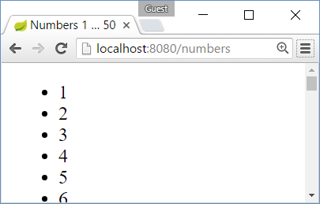
Example: Print the Numbers 1…50
Create an action /numbers + view numbers.html
HelloController.java
templates/numbers.html
@Controller
public class HelloController {
@RequestMapping("/numbers")
public String numbers() {
return "numbers";
}
}
…
<ul><li th:each="i : ${#numbers.sequence(1, 50)}"
th:text="${i}" /></ul>
…

Slide 17
Example: Greeting Controller
Create an action /greeting to say hello to its parameter "name"
src/main/java/app/controllers/GreetingController.java
package app.controllers;
@Controller
public class GreetingController {
@RequestMapping("/greeting")
public String greeting(@RequestParam(value="name",
defaultValue="unknown") String name, Model model) {
model.addAttribute("name", name);
return "greeting";
}
}
Take a HTTP GET request parameter named "name"
Put the name into the model and render view "greeting.html"

Slide 18
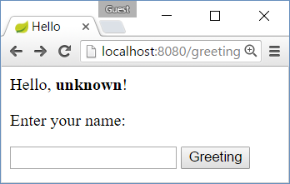
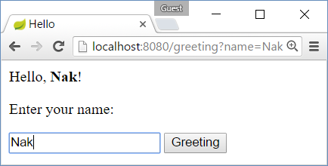
Example: Greeting View
Create a view to say hello to its model property "name"
src/main/resources/templates/greeting.html
<!DOCTYPE html>
<html xmlns:th="http://www.thymeleaf.org">
…
Hello, <b><span th:text="${name}" /></b>!
<form>
Enter your name:
<input type="text" name="name"/>
<input type="submit" />
</form>
…
Greeting to ${name}
HTML form to submit name

Slide 19
Creating Simple Spring MVC App
Create new Maven project in your IDE
Add dependences in pom.xml to Spring Boot + Spring MVC + Thymeleaf
Create the Spring Boot application class: @SpringBootApplication
Create REST controller + actions: / shows "hello"; /date shows the date
Create Web controller + action + view: /hello shows "hello" (use model)
Configure auto-reload on change: application.properties + pom.xml
Create action + view: /numbers to prints the numbers 1 ... 50
Create action + view: /greeting?name=Peter to greet Peter
Live Exercise in Class (Lab)

Slide 20
Spring Annotations
Spring uses strongly-typed annotations
Syntax highlighting + error checking
@Controller
public class HomeController {
…
}
Annotations describe the code below them
Configure Access Control
@PreAuthorize("hasRole('ROLE_ADMIN')")
public String adminPanel(Model model) {
…
}

Slide 21
Spring Controllers
Defined with the @Controller annotation:
Controllers can hold multiple actions on different routes
@Controller
public class HomeController {
…
}
@RequestMapping("/hello")
public String hello(Model model) { … }
@RequestMapping("/welcome")
public String welcome(Model model) { … }

Slide 22
Controller Actions
Annotated with with @RequestMapping(…)
Or @GetMapping(…) / @PostMapping(…)
@RequestMapping("/home")
public String home() {
return "home-view";
}
@GetMapping("/home")
public String home(Model model) {
model.addAttribute("view", "home");
return "base-layout";
}

Slide 23


Thymeleaf
Thymeleaf is a view engine used in Spring MVC
Natural templates – HTML with additional attributes to add view logic
Thymeleaf allows us to:
Use variables / collections in our views
Execute operations on our variables
Iterate over collections
Notes:
http://www.thymeleaf.org/doc/tutorials/3.0/usingthymeleaf.html

Slide 24
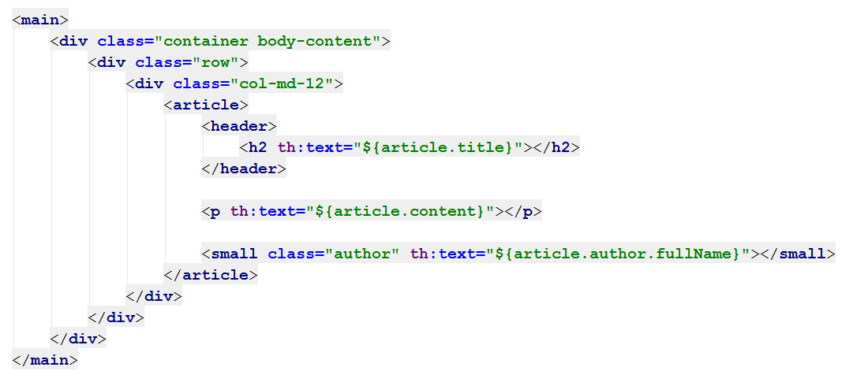
Thymeleaf: View Templates
Thymeleaf syntax
HTML
Syntax
Thymeleaf syntax
Thymeleaf syntax

Slide 25
Example: List Files
Create an action Files to show the folders and files in C:\
controllers/FilesController.java
templates/files.html
@RequestMapping("/files")
public String files(Model model) {
File path = new File("c:\\");
File[] allFiles =
path.listFiles();
model.addAttribute(
"allFiles", allFiles);
return "files";
}
<h1>Files</h1>
<div th:each =
"file : ${allFiles}"
th:text = "${file.name}">
</div>

Slide 26
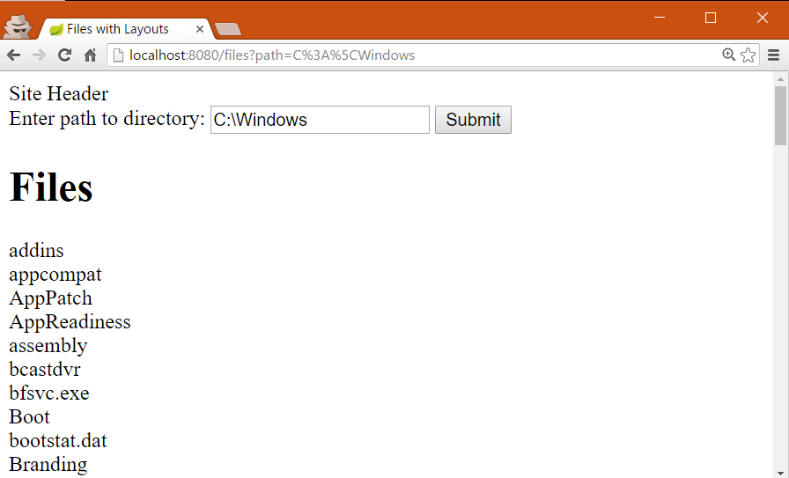
Example: List Files in Specified Folder

Slide 27

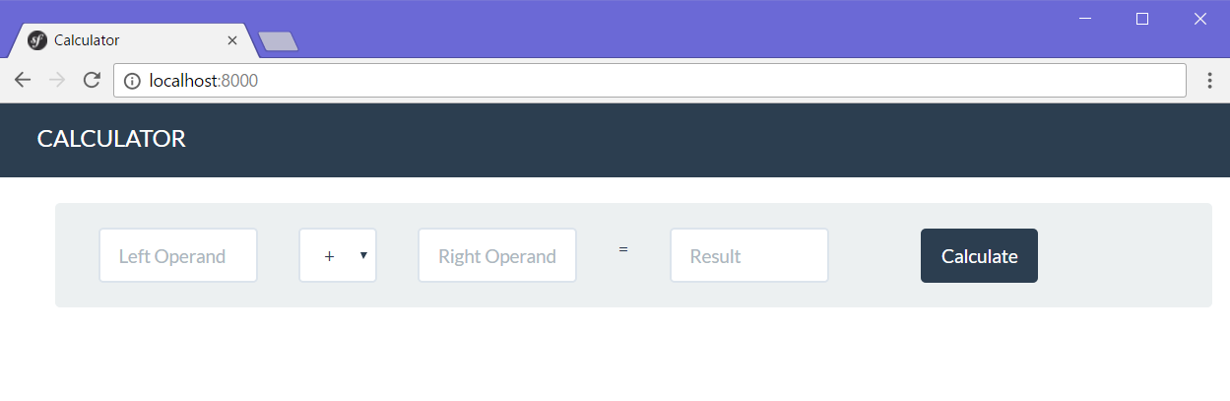
Web Application with Spring MVC
Live Exercises in Class (Lab)

Slide 28

Summary
Build robust web applications with Java, using
Spring MVC
Open Source MVC Web Framework for Java
Controller handling, annotations
Spring Boot
Configures and simplifies Spring apps
Thymeleaf
Powerful view engine
Variables, Iteration, Conditions

Slide 29








Software Technologies – Java Basic Web
https://softuni.bg/courses/software-technologies

Slide 30
License
This course (slides, examples, demos, videos, homework, etc.) is licensed under the "Creative Commons Attribution-NonCommercial-ShareAlike 4.0 International" license

Slide 31





Trainings @ Software University
Software University Foundation – softuni.org
Software University – High-Quality Education, Profession and Job for Software Developers
softuni.bg
Software University @ Facebook
facebook.com/SoftwareUniversity
Software University Forums – forum.softuni.bg

